Slide 1
Legacy Found: A practical guide to Stewarding your Stuff

Slide 2
Leader’s Introduction
Boston College professor Paul Schervish has estimated that over the next few decades elders and baby boomers will pass in excess of $41 trillion to the next generation. The Wall Street Journal has called this a “watershed event in world history”. And while major universities and mega charities clamor for their “piece of this pie”, the local church is tragically standing on the sidelines as a spectator. Pastors and church leaders rely myopically on Sunday morning offerings and the occasional special campaign. Certainly, these mechanisms have biblical roots and provide sustenance for week to week ministry. But as universities build multibillion-dollar endowments, pastors are left to survive in a scarcity mentality. The tragedy here is not limited to reduced ministry outcome, although that is significant in a church impact context. But as we see in scripture, God will get his work done whether we stand by wringing our hands or engage and participate in this wealth transfer in a meaningful way.
The bigger tragedy might be the discipleship vacuum that we leave as a church with our members. The average American has 9% of their net worth in cash while 91% is in assets. As the church limits its stewardship conversation to offerings and cash, mega universities and charities are “helping” our church members determine how they might leave a legacy with their 91% that is represented by assets.
We are abdicating wisdom and even discipleship of wealth to secular universities who often stand diametrically opposed to a biblical value system. To the uninformed church member, giving to a new science building at a college or giving to the church are in both cases giving to charity. We need to offer a perspective on how their legacy, be it small or large, can have life-changing impact for the cause of Christ.
This conversation can be hard for pastors to engage in, and so we want to crack the door open on this dialogue in a conversational video series entitled Legacy Found: A practical guide to Stewarding Your Stuff.
The audience for most churches will be the 55-year-old and above member. The setting will be an adult Sunday school class, small group or perhaps a Saturday morning session. Our prayer is that we can help churches across the country move from being a spectator to a vibrant, wisdom-giving participant in the greatest transfer of wealth in the history of the world.

Slide 3
Legacy Found: Session 1
What values do we want to pass down to our children?
2) What wakes you up at 3 o’clock in the morning?
Family Issues
Impact Issues
Tax Issues
Are we being smart with our stewardship? Are we giving pretax or after tax dollars?
4) How can we, as a church, tie legacy, stewardship and worship together?

Slide 4
Legacy Found: Session 2
The average American has % in cash and % in assets.
2) Barnabas sold a he owned and brought the money and laid it at the apostle’s feet.
Today he would pay long term capital gains tax if the was an appreciated asset.
The one asset the most Americans will be taxed on at death is
.
4) I can eliminate that tax by changing my beneficiary.

Slide 5
Legacy Found: Session 3
If I sell an appreciated asset and then give cash, I get a charitable deduction. If I carve off a piece of that asset and give before the sale, I get benefits.
Hotel Dieu operated free of charge to serve the poor from 1443 to the late . All because one couple took the initiative.
Look for ways to give out of dollars vs dollars.
When I give out of assets, am I giving things I have worked hard for my whole life? ______________________________________
Or am I giving back to God a portion of what he has given me?
_________________________________________________
_________________________________________________

Slide 6
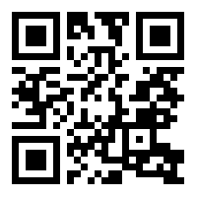
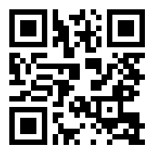
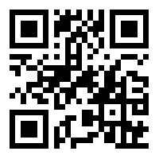
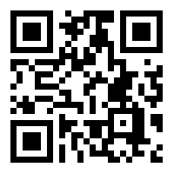
Legacy Found Session 4: Serving the Masses
How can I eliminate taxes while also benefiting my church and other charities?
Unexpected Taxes on my IRA
Can I give out of my IRA during my lifetime?
IRA Rollover video
If I wanted to give 10% of my estate to charity, what is the best way to do that?
Giving Out of My Qualified Plan
What’s the first step?
Discovery Call

Slide 7
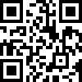
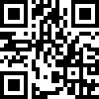
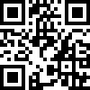
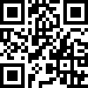
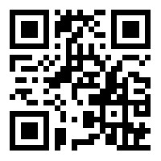
Legacy Found Session 4: Surfacing the Few
How can I reduce taxes and benefit charity when producing income producing real estate?
Nebraska Farm Couple
Texas Warehouse
Is vacation property a good gift for charity?
Lakehouse
3) My balance sheet has grown and I’m considering liquidating assets.
Widow and the Dog
4) I already have advisors.
Do we compete with your advisors?

Slide 8
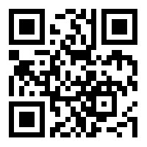
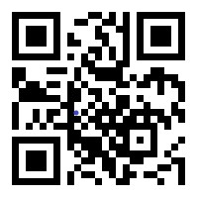
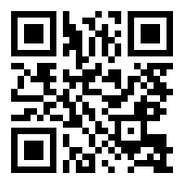
Legacy Found Session 4: Surfacing the Few (cont.)
5) I’m not sure if I need help or not.
Why use The Giving Crowd?
Three Questions
6) Considerations regarding inheritance.
Inheritance Challenges

Slide 9
Mission Statement:
Leveraging technology, expertise and platform, we disrupt and reposition philanthropy to create a future that is no longer groveling in the 9%, but actively releasing the 91%.
Process:
Introduction/Getting to Know You: This is a very personal conversation. You may want to get comfortable with us while we get to know you. (1-2 hours, this can be in person or by Zoom video call)
Goals/Data Gathering: We want to understand your journey rather than assume we do and plug in some “boiler plate” designs. (1-2 weeks)
Preliminary Proposal: This is our first attempt to match your life journey with some new solutions. (2 weeks)
Proposal Revisions: Often, folks will adjust their goals or the outcome once they see some new options they did not know about before. (2 weeks)
Implementation: None of this does you any good until you take action and put it on paper. We will walk with you as you take these steps. (1-3 months for a new estate plan or a proposed business sale structure)

Slide 10
So let’s talk…
• We do not sell insurance.
• We do not manage assets.
• We do not receive a commission on gifts you create
• We will work with your advisors.
• Our aim is to offer an environment that is free of bias and conflict of interest. We are a “safe third party” with no side agenda or ulterior motive. If we have a bias, it is one of helping you engage and enjoy maximizing what you have worked a lifetime for, to the benefit of your family and the charitable organizations that have impacted your family.
• This is expertise offered by your church to serve you. It is offered without obligation but with the hope that if the church has blessed your family, you might remember and invest in the current and future ministry impact of this body.
The Giving Crowd
972-850-9503
info@givingcrowd.co
Givingcrowd.co

Slide 11
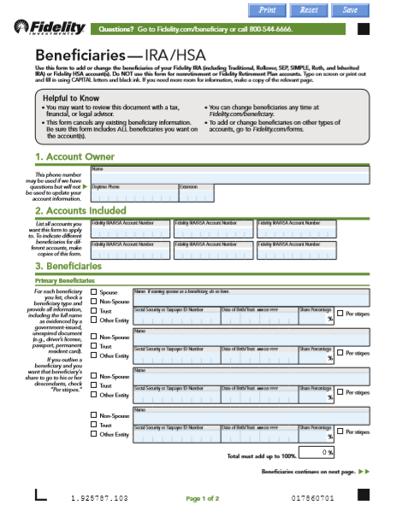
Sample

Slide 12
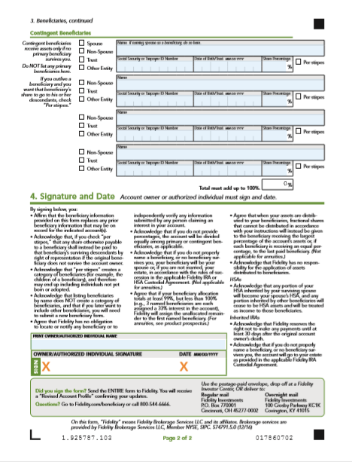
Sample

Slide 13
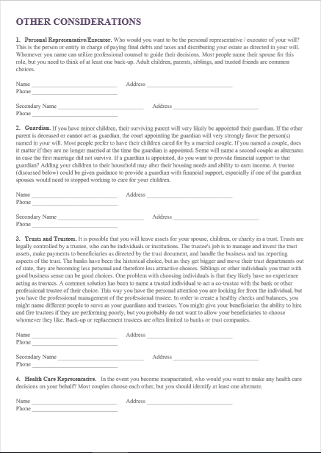

Slide 14
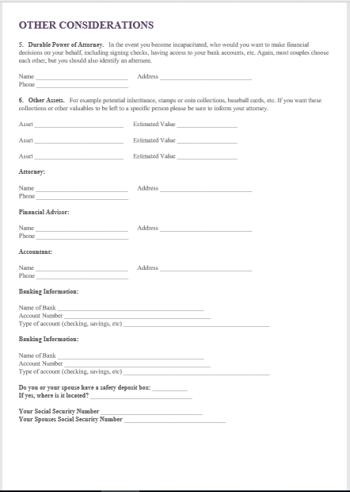

Slide 15
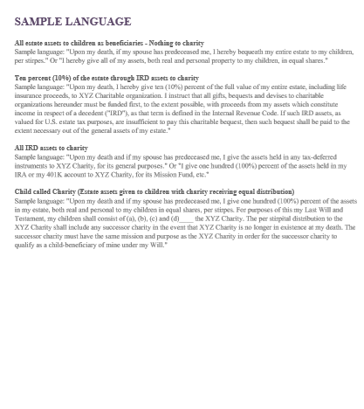

Slide 16
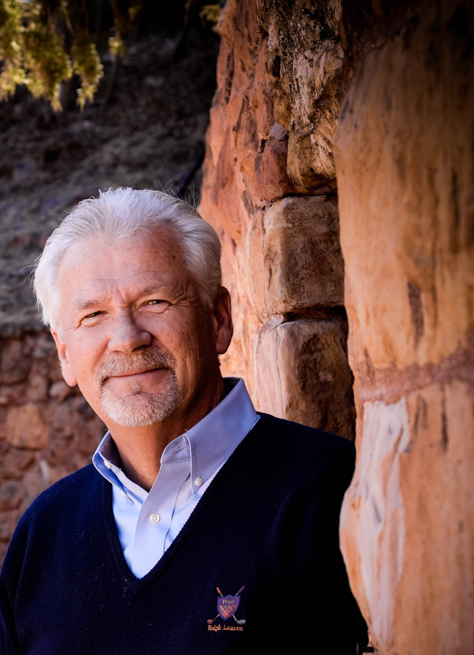
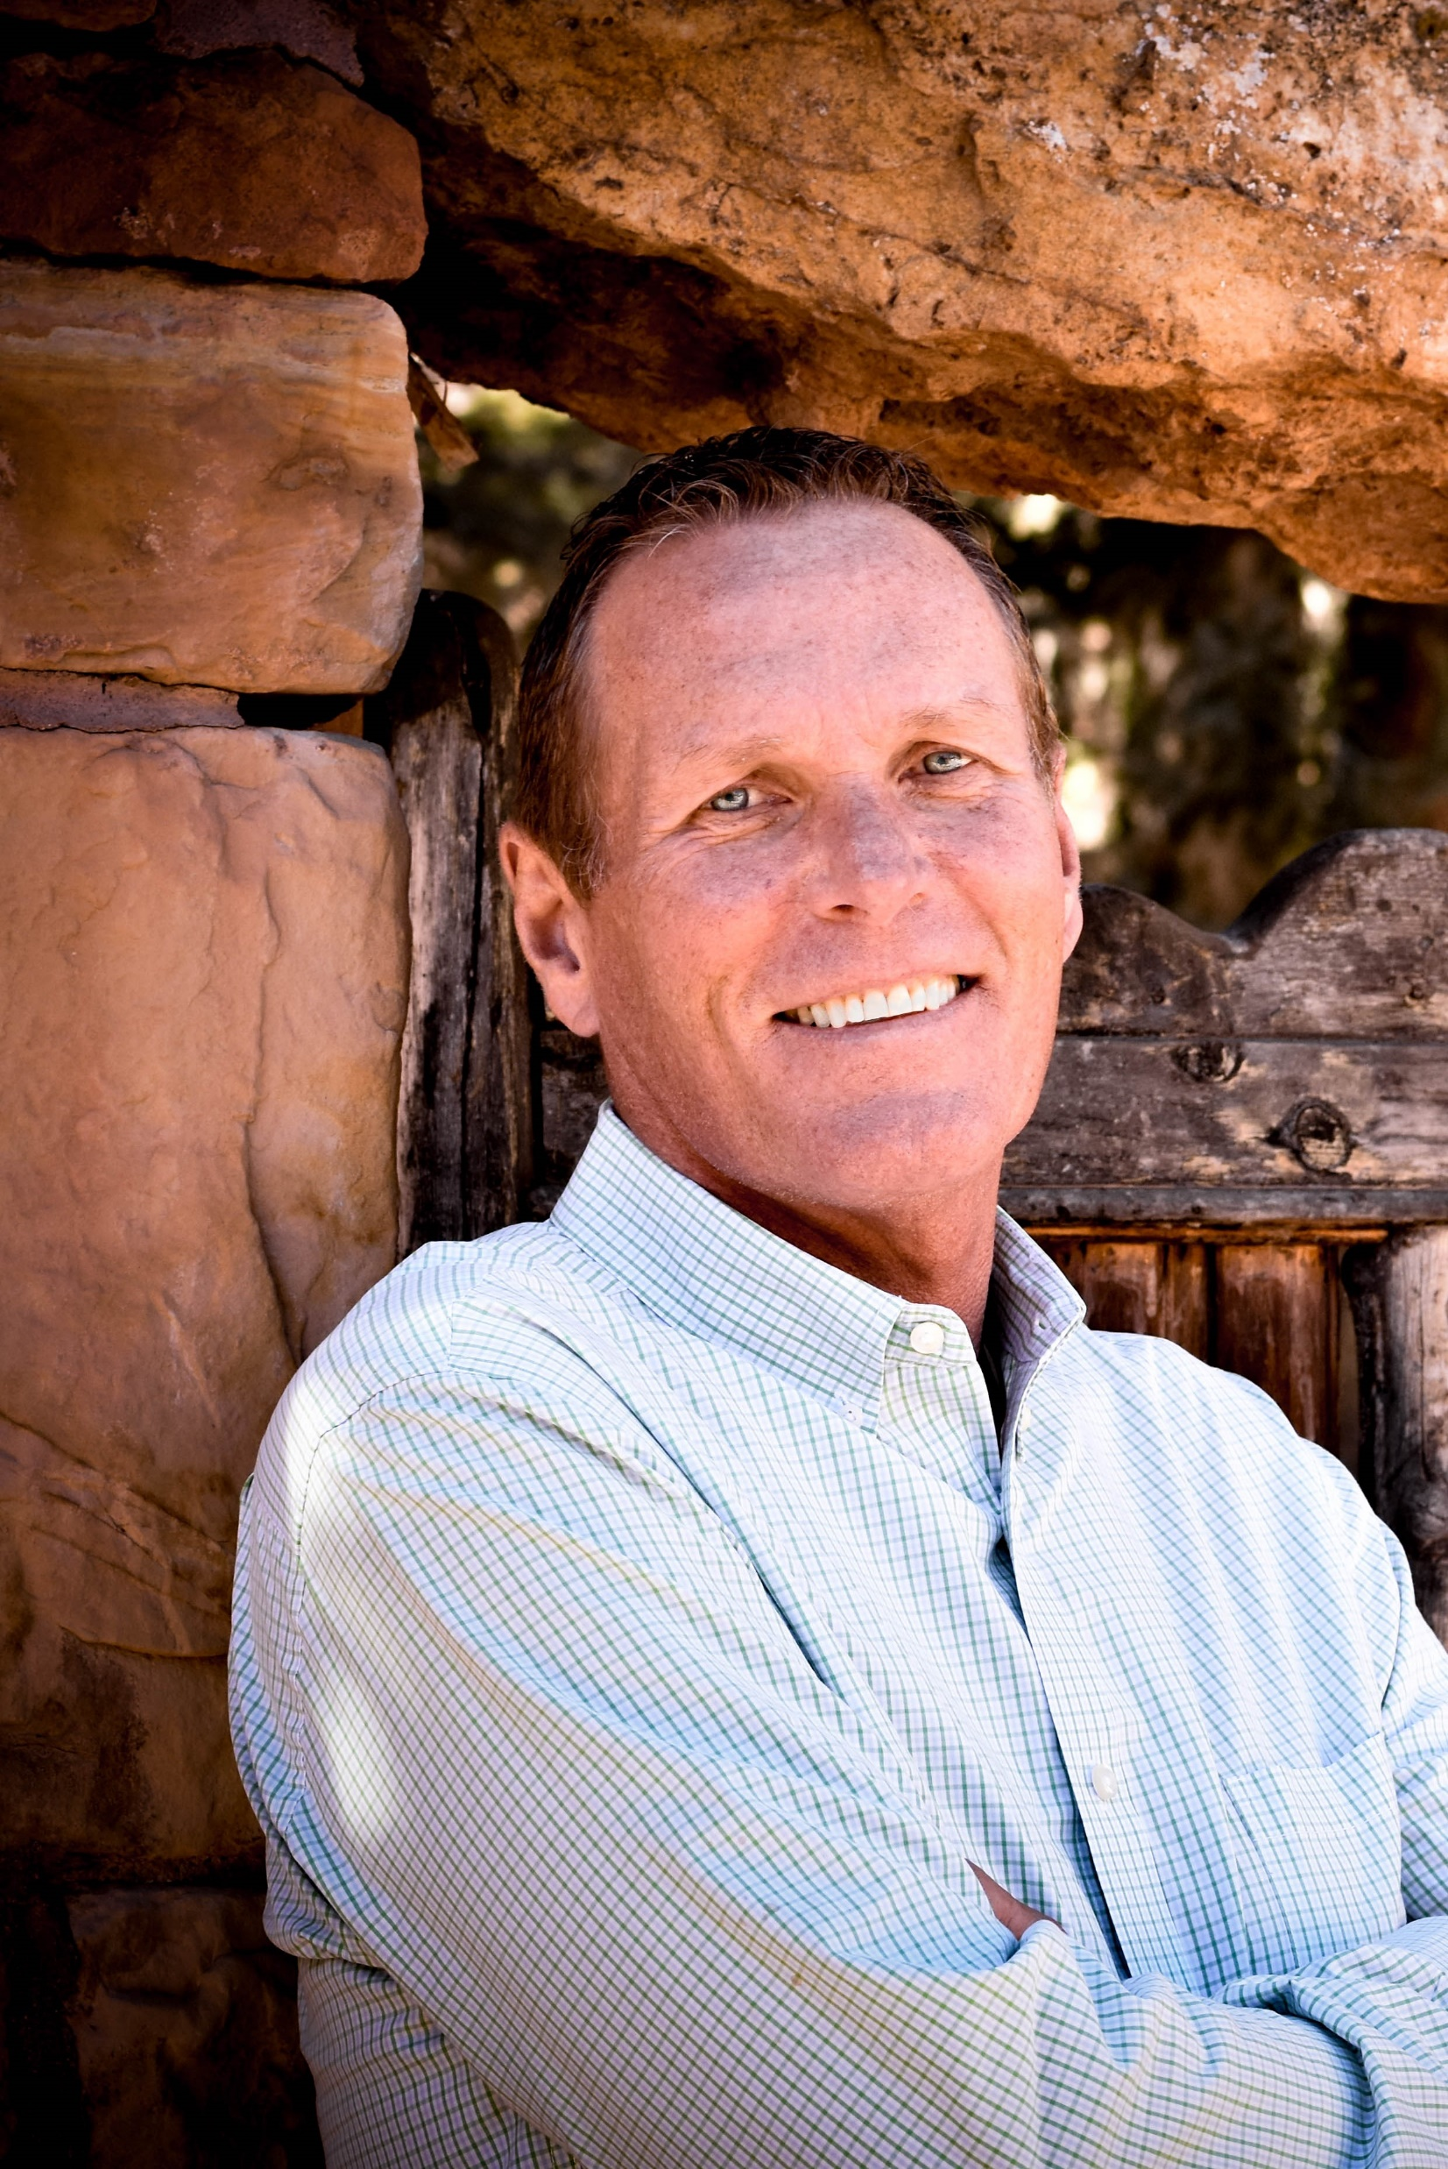
About The Giving Crowd
Greg Ring Co-Founder Greg Ring (Co-Founder) has been a recognized expert and thought leader in the Planned Giving arena for the past three decades. The firms launched by Greg have served more than 200 ministries and nonprofits, developing and executing more than $4 billion in documented planned gifts. He has been a guest lecturer on 4 continents and across America. Greg and his wife Sue met in college through a campus ministry "a long time ago". They have three daughters and six grandchildren, and live in Colorado Springs. Sue is very involved in mentoring young moms, and together they host a "home group" through their church.
Richard Blackmon Co-Founder Richard Blackmon (Co-Founder) has spent the past 15 years working on current gifts in the non-profit arena. He has helped clients raise several hundred million dollars and has led a consultancy that has conducted some of the largest "major donor efforts in history" - (over 20 billion dollars raised). Before co-founding The Giving Crowd he served as CEO and President of one of the largest companies in America providing services to a wide variety of non-profit market verticals. Richard is married and lives in Dallas.
15707 C Coit Road, Suite 166, Dallas, TX 7524 ~ 719.393.2485

